Slide 1

An Introduction
To Design Thinking
Ritwik Raha
GDG Kolkata
Cloud Study Jam
AOT
ritwik@tcfindia.in

Slide 2

About Me
Co-Founder, CEO at The Code Foundation
Developer, Designer, UX Enthusiast
Linkedin: www.linkedin.com/in/ritwik-raha/
Github: github.com/ritwikraha
Behance: www.behance.net/ritwikraha
Dribble: https://dribbble.com/RitwikR

Slide 3
So, What is Design Thinking?
“Design thinking is a human-centered approach to innovation that draws from the designer's toolkit to integrate the needs of people, the possibilities of technology, and the requirements for business success.”
— Tim Brown, CEO of IDEO

Slide 4

Focus on Humans First
Design Thinking is user-centric. It seeks to understand people’s needs and come up with effective solutions to meet those needs. Design Thinking is a solution based approach to problem solving

Slide 5
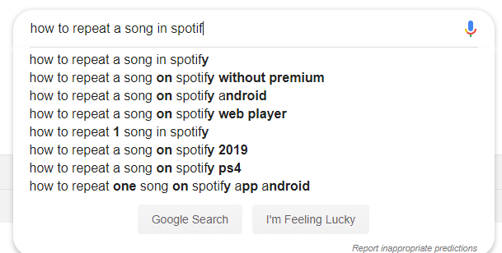
Never do this to a user

Slide 6
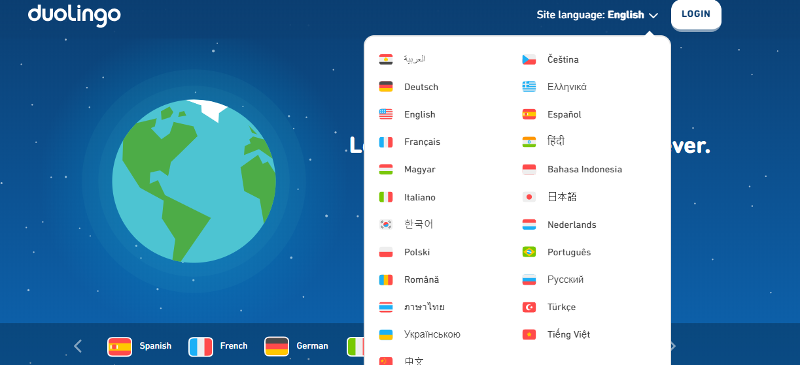
Duolingo: A good example of user centric design

Slide 7

Back to
Design
Thinking
Empathise
Define
Ideate
Prototype
Test

Slide 8
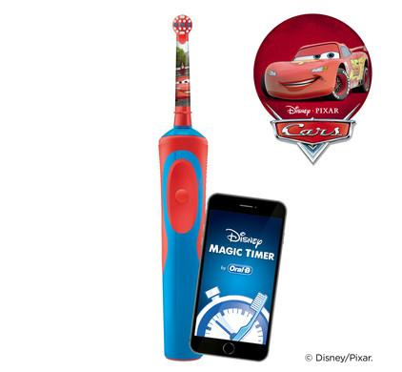
Empathise
with your users
Oral B decided to observe children brushing their teeth to determine any differences that needed to be accounted for. They found that children hold their toothbrushes in a different way to their adult counterparts, due to their small hands — and so they were finding regular ‘adult’ toothbrushes difficult to use. To solve this, they redesigned children’s toothbrush to include a squish gripper to make it easier for them to manipulate the brush in their mouth — and in the process, innovated children’s toothbrushes, to what we know today.

Slide 9
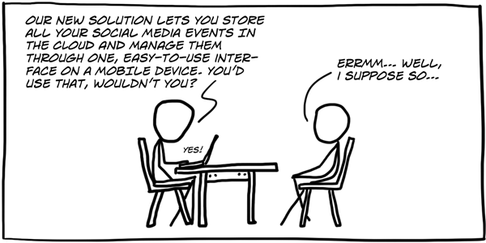
Phase two:
Define
This is where the designer needs to be clear with the problem he/she is solving.
What is the user problem that is to be solved?
What are the difficulties/barriers if any?
Rather than saying “we need to..” start practicing saying things like “senior citizens in the city need to use the ‘track your train’ app”

Slide 10

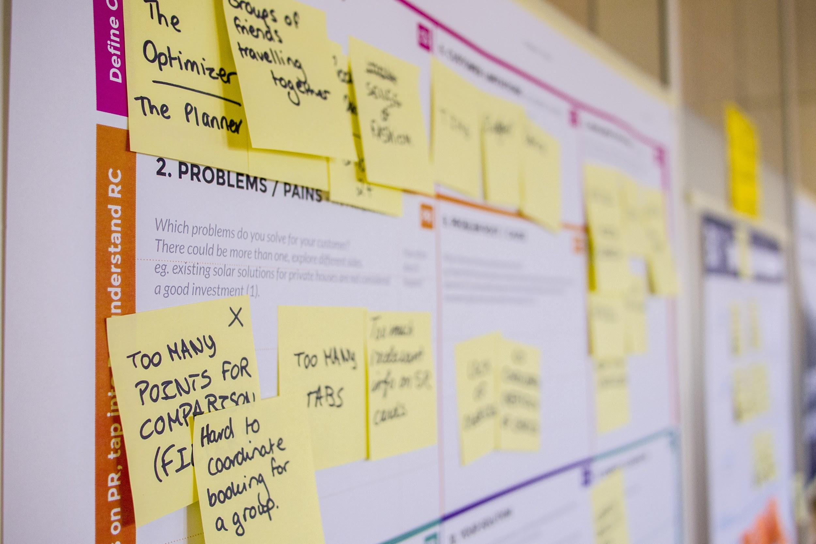

Phase three Ideate
Create analogies
Brainstorm
Challenge Assumptions
Mindmap what you ideate
Storyboarding

Slide 11
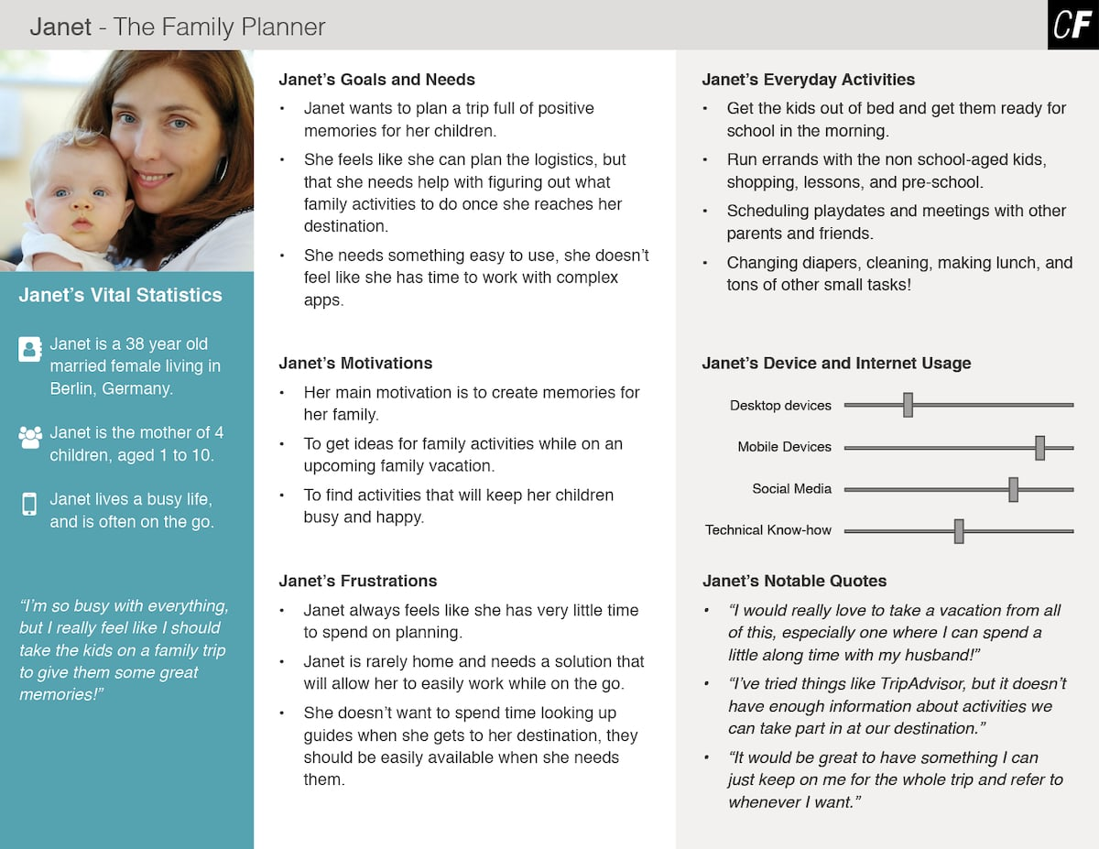
A typical
User Persona

Slide 12
Prototype
A prototype is basically a scaled-down version of the product which incorporates the potential solutions identified in the previous stages. This step is key in putting each solution to the test and highlighting any constraints and flaws.

Slide 13
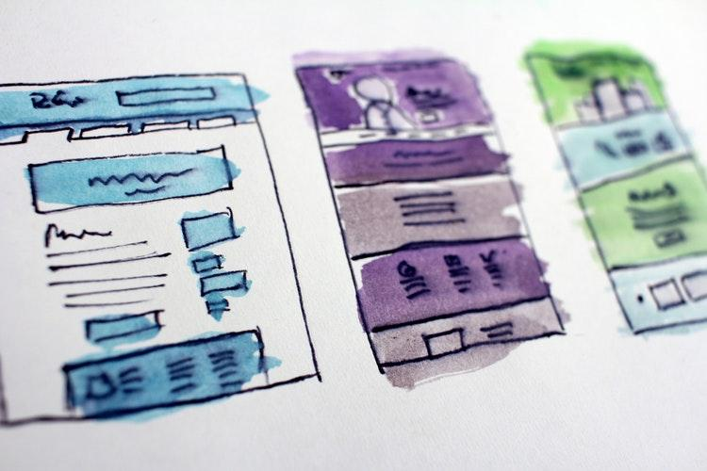
A low fidelity
proto-type
can be as neat as this

Slide 14
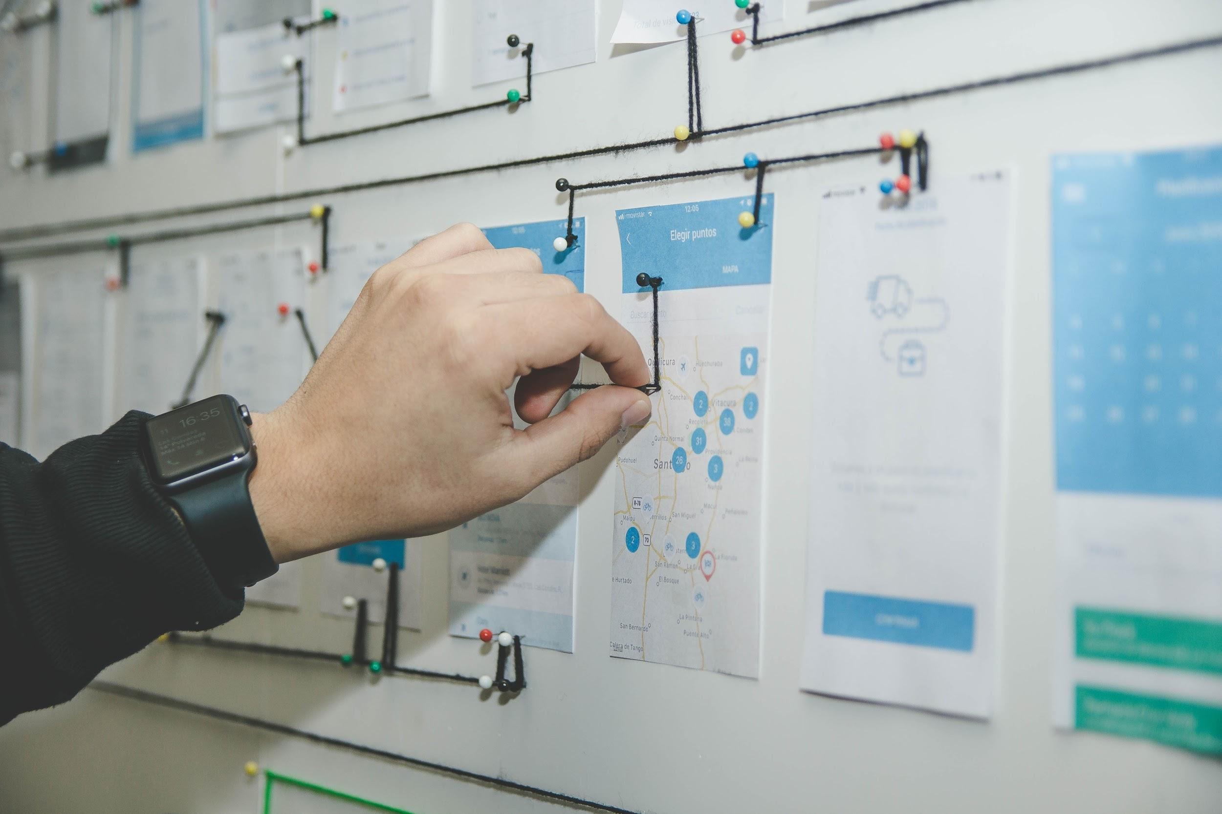
Or as detailed
as this

Slide 15
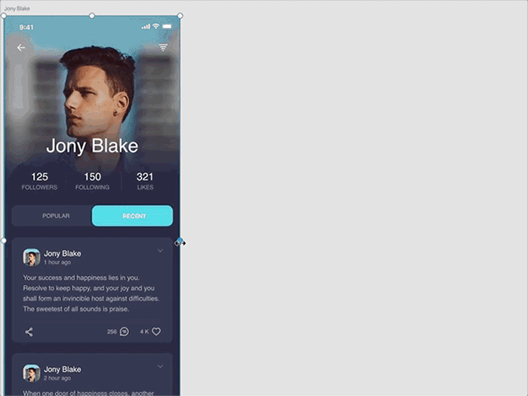
Medium Fidelity
Clickable
Prototypes

Slide 16

High Fidelity
Animations & Transitions

Slide 17
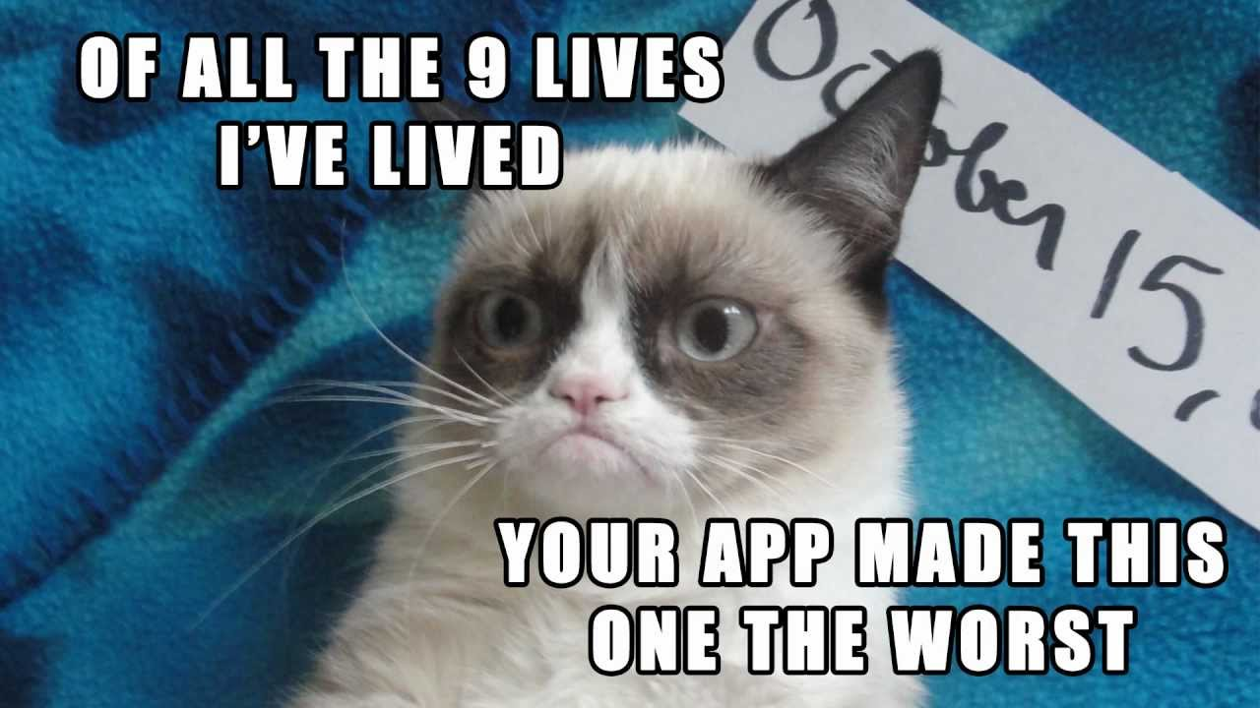
What next?
USER TESTING

Slide 18
Here’s the catch
Design Thinking is a non-linear process. So, dive in anyway.

Slide 19
A Little Gift!
Free UI kits (.xd and .psd)
UX books to kickstart
Mockups for presentations
A general Assets library
bit.ly/2GhPXCM

Slide 20
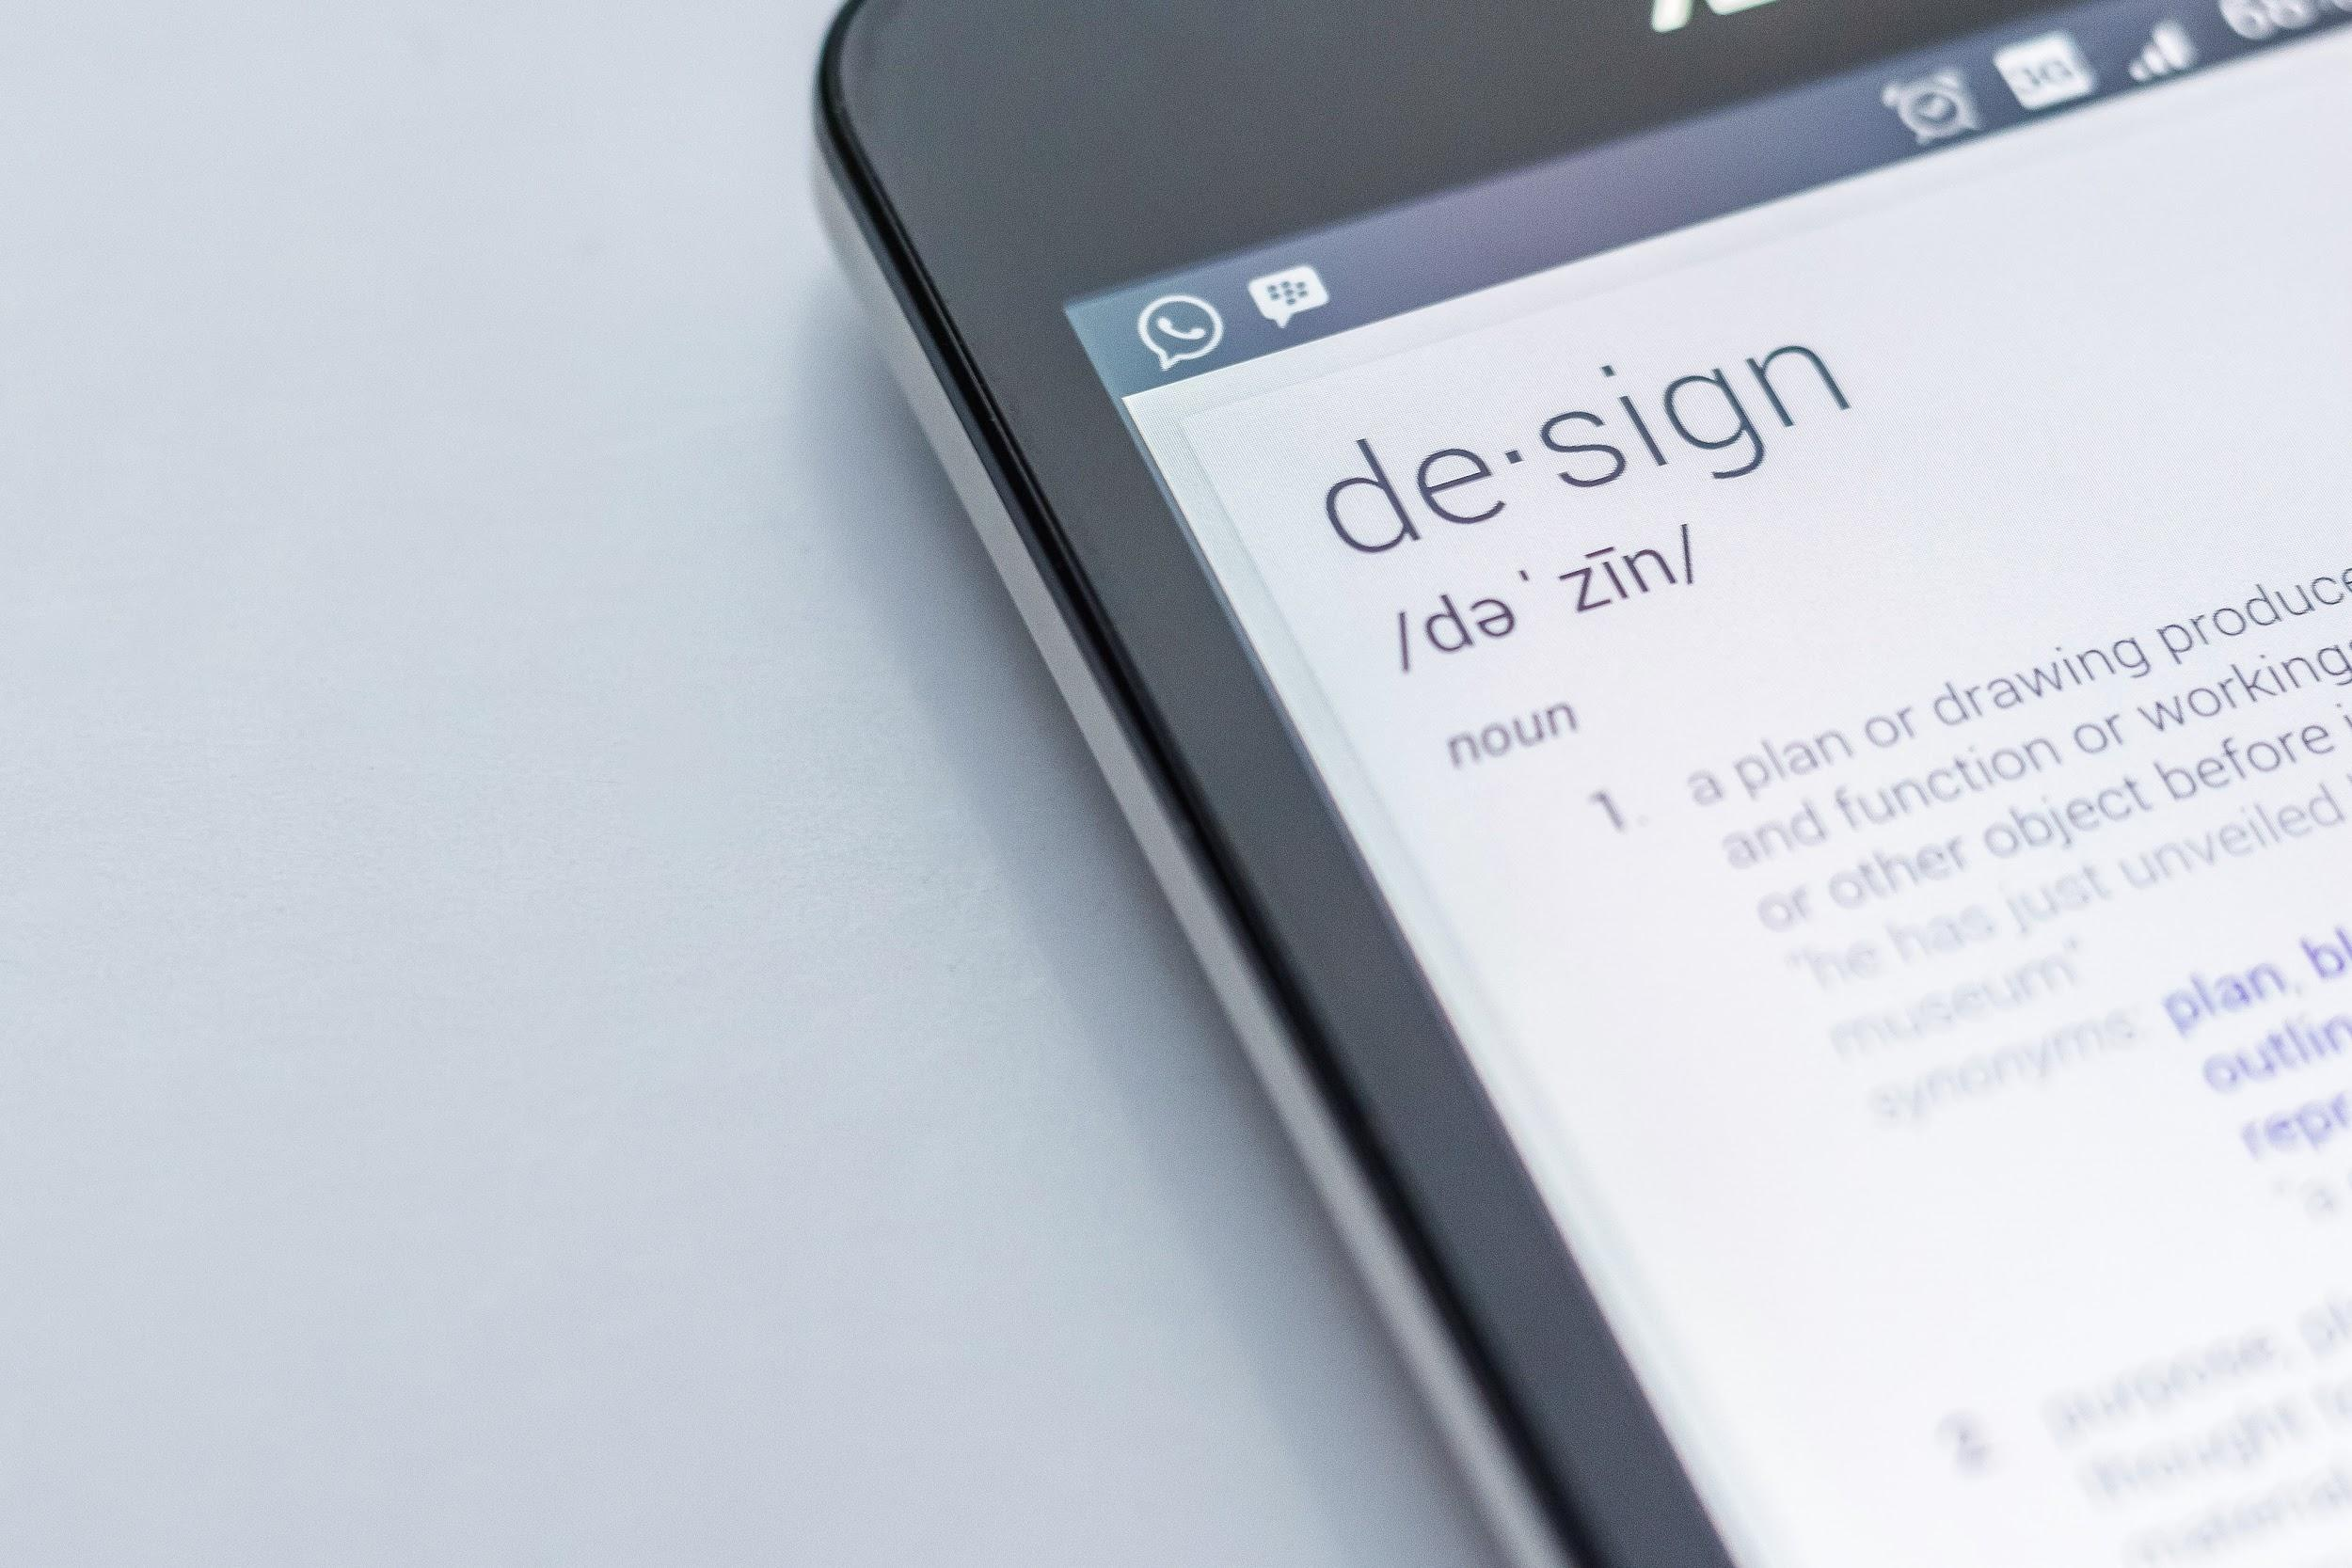
THANK YOU

